Slide 1
EMOTION RECOGNITION BY INCLUSION OF AGE AND GENDER PARAMETER BY DEEP LEARNING
Project Guide : Ms Joylin Priya Pinto
Asst .Prof GD-1
PRESENTED BY
Aditya Murugan
Akil Raif Ashwamedh Arote Adithya Holla k
4nm19cs010 4nm19cs014 4nm19cs031 4nm19cs007

Slide 2
Problem Definition
1
2
Literature Survey
3
CONTENT
System Specifications
4
System Design
5
System Implementation
6
Screen Shorts of Output
7
Conclusion And Future Work

Slide 3
The main motive is to develop an age and gender estimation method towards human faces which will continue to possess an important role in computer vision and pattern recognition. Apart from age estimation, facial emotion recognition also plays an important role in computer vision. This implementation proposes a new framework of Convolutional Neural Network for the simultaneous tasks of age estimation, gender recognition and emotion recognition on face images.
PROBLEM DEFINITION

Slide 4
LITERATURE SURVEY
LITERATURE PAPER
ABSTRACT
Detection of Gender, Age and Emotion of a Human Image using Facial Features
Apart from age estimation, facial emotion recognition also plays an important role in computer vision.
Non-verbal communication methods are used in many applications of human computer interaction.
In order to create computer modeling of humans age, gender and emotions a plenty of research has been accomplished.

Slide 5
LITERATURE SURVEY
LITERATURE PAPER
ABSTRACT
Facial emotion recognition using deep learning: review and insights
Automatic emotion recognition based on facial expression is an interesting research field.
With the remarkable success of deep learning, the different types of architectures of this technique are exploited to achieve a better performance.
The purpose of this paper is to make a study on recent works on automatic facial emotion recognition FER via deep learning.

Slide 6
LITERATURE SURVEY
LITERATURE PAPER
ABSTRACT
Gender , Age , Emotion recognition using Convolutional Neural Network
Automated age and gender detection has been generally used in our daily lives.
The existing methods have quite satisfying performance on real-world images if facial expressions of input image is neutral or calm, it lacks significantly in age prediction when facial expressions are altered.
An improvement in the performance of these tasks was observed by using the convolutional neural-nets (CNN).The accuracy of the wide- resnet model is 96.26% and for the emotion recognition model, accuracy achieved is 69.2%.

Slide 7
For the identification of age and gender, the existing system used sigmoid activation function. Because the model had not been trained with enough images, the previous system had faults. We now employ the ReLU activation function in the present system since it is substantially quicker then the sigmoid function and does not simultaneously activate all neurons The correctness of the outcome is one of the suggested system's drawbacks. When the training data set is increased to a much larger amount, this can be mitigated.
Existing and Proposed System with Limitations

Slide 8
SYSTEM SPECIFICATIONS
HARDWARE REQUIREMENTS
SOFTWARE REQUIREMENTS
CPU Intel Pentium 2 or higher. 2 Cores Minimum dual core.
Memory 8 GB or higher.
Hard Disk space 100 GB or higher
Ngrok
Keras
Tensor Flow

Slide 9
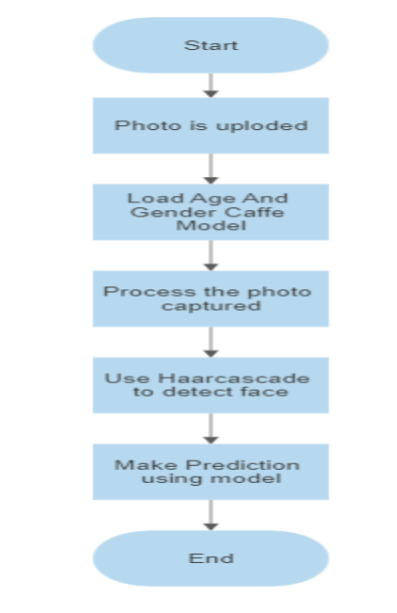
SYSTEM IMPLEMENTATION
WORKING OF AGE, GENDER PREDICTION

Slide 10
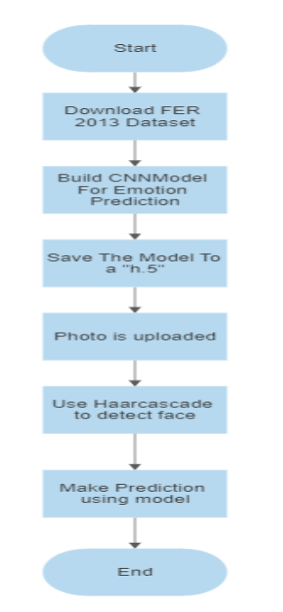
SYSTEM IMPLEMENTATION
Working Of Emotion Prediction

Slide 11
The proposed framework is capable of emotion recognition, age estimation and gender recognition simultaneously in a fast and efficient way. Misclassifications might occur because people from different ethnic groups have different facial characters, which might slightly alter the actual age from the predicted age. The use of glasses might affect the emotion classification by interfering with the features learned. Finally, it would be interesting to implement this model on a live business service. This project can be applied in social media to customize advertisements and content, in e- commerce to customize product listing and in entertainment industry to customize OTT
T
CONCLUSION AND FUTURE WORK

Slide 12

OUTPUT

Slide 13
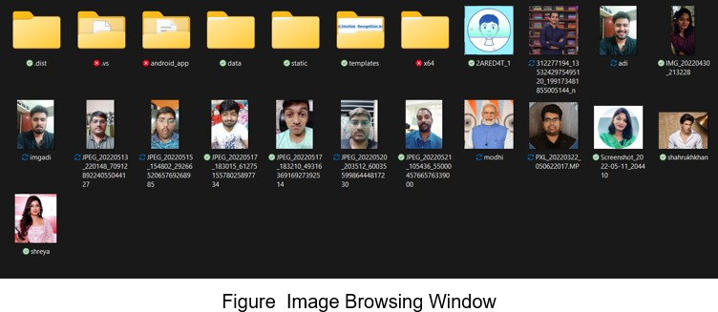
OUTPUT

Slide 14
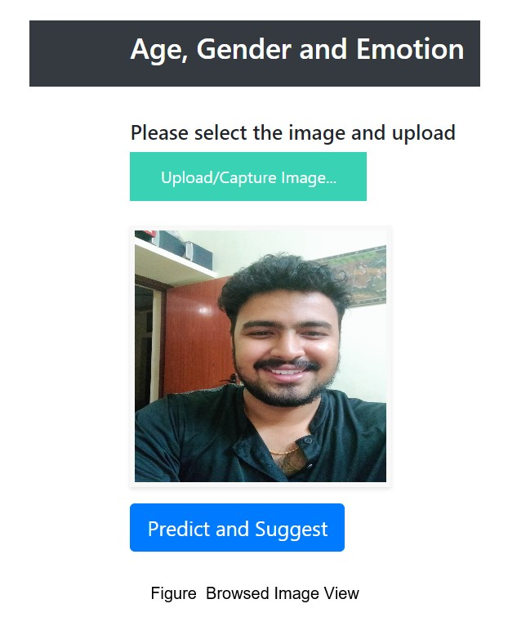
OUTPUT

Slide 15
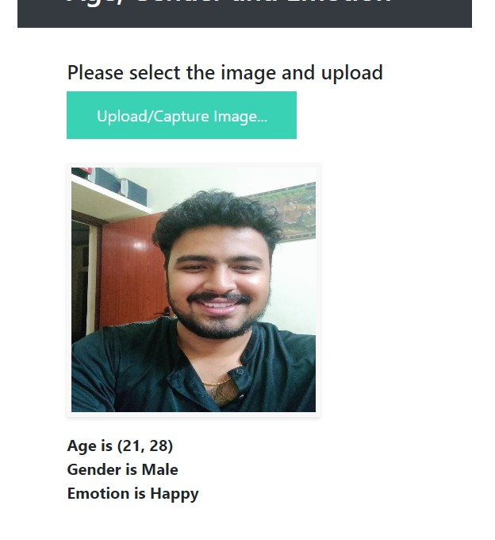
OUTPUT

